Slide 1






Hospital Data SQL Analysis Project

Slide 2

Project Overview
Fictional Hospital Database analysis in PostgreSQL.
Simulated real-world healthcare reporting for decision-making.
Overview
Insights: patient volume, doctor availability, stay durations, demand, and cost efficiency.

Slide 3
Dataset Used
- department
- patients_count
- admission_date
- discharge_date
Table:
hospital



- doctors_count
- medical_expenses
●
Columns:
- hospital_name
- location


Slide 4
Objectives
• Analyze patient loads
• Compare performance city-wise
• Evaluate doctor availability
• Measure stay duration
• Monitor expenses
• Improve efficiency

Slide 5
Business Problems
• City with highest demand
• Total patients treated
• Top expense hospitals
• High/low patient volume departments
• Overburdened departments
• Cost per patient-day
• Avg. stay by department

Slide 6
Methodology
02
Advanced analysis
Data assumption & preparation
01
04
KPI modeling
Basic SQL exploration
03
05
Insights generation

Slide 7
Key Insights
• Total patient volume
• Top crowded departments
• Cost per day per hospital
• Top spending hospital
• Longest stay case

Slide 8
Key Insights
• City-wise patient distribution
• Monthly expenses trend
• Avg. stay duration
• Underutilized departments

Slide 9
Skills Gained
• Grouping, ranking, summarizing
• Healthcare data analytics
• Business-focused SQL queries
• Date & financial calculations
• Translating KPIs to SQL

Slide 10
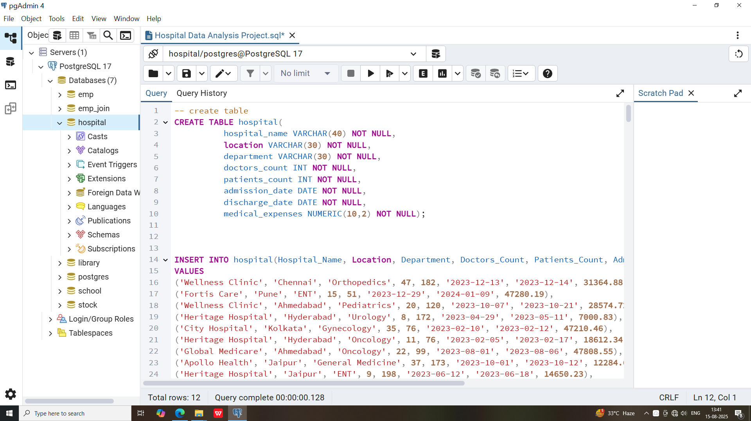
Sample Table

Slide 11
Sample SQL Queries
Advanced:
patients per city, avg. doctors, avg. stay by dept, highest expenses, cost/day, monthly expenses, least patient dept, longest stay
Basic:
hospitals in Bangalore, <50 patients, admission after 2023-01-01, <10 doctors

Slide 12
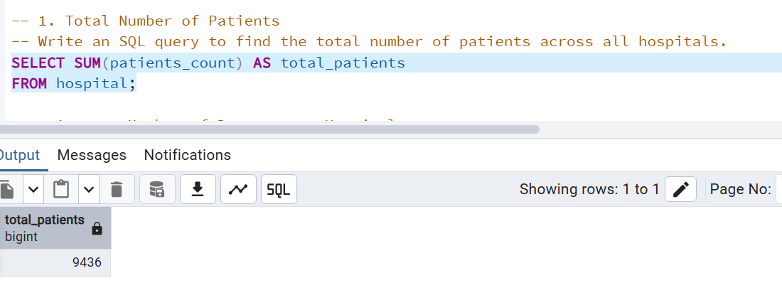
Sample SQL Queries
1. Total Number of Patients
Basic:
hospitals in Bangalore, <50 patients, admission after 2023-01-01, <10 doctors
SELECT SUM(patients_count) AS total_patients
FROM hospital;

Slide 13
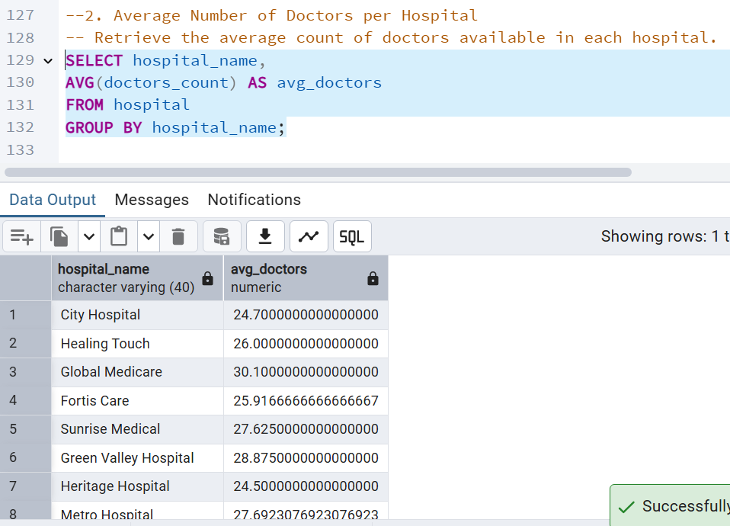
Sample SQL Queries
2. Average Number of Doctors per Hospital
Basic:
hospitals in Bangalore, <50 patients, admission after 2023-01-01, <10 doctors
SELECT hospital_name,
AVG(doctors_count) AS avg_doctors
FROM hospital
GROUP BY hospital_name;

Slide 14
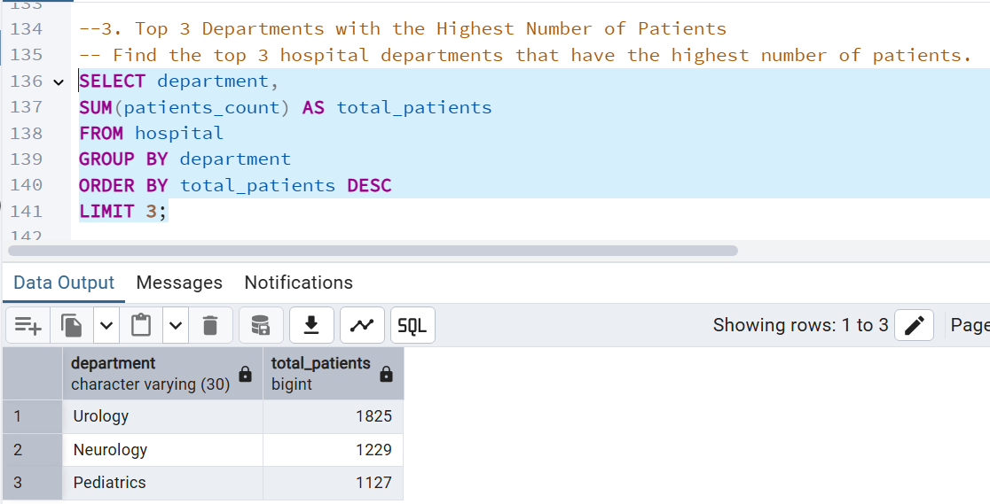
Sample SQL Queries
3. Top 3 Departments with the Highest Number of Patients
Basic:
hospitals in Bangalore, <50 patients, admission after 2023-01-01, <10 doctors
SELECT department,
SUM(patients_count) AS total_patients
FROM hospital
GROUP BY department
ORDER BY total_patients DESC
LIMIT 3;

Slide 15
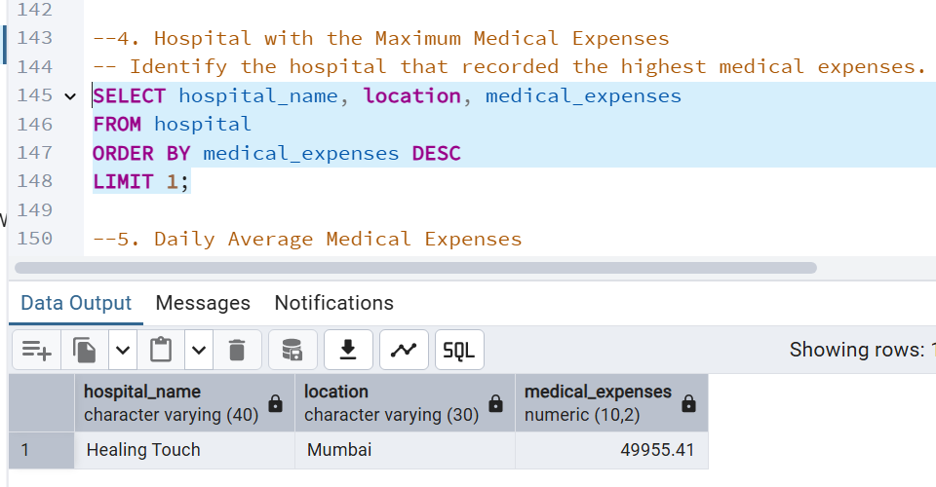
Sample SQL Queries
4. Hospital with the Maximum Medical Expenses
Basic:
hospitals in Bangalore, <50 patients, admission after 2023-01-01, <10 doctors
SELECT hospital_name, location, medical_expenses
FROM hospital
ORDER BY medical_expenses DESC
LIMIT 1;

Slide 16
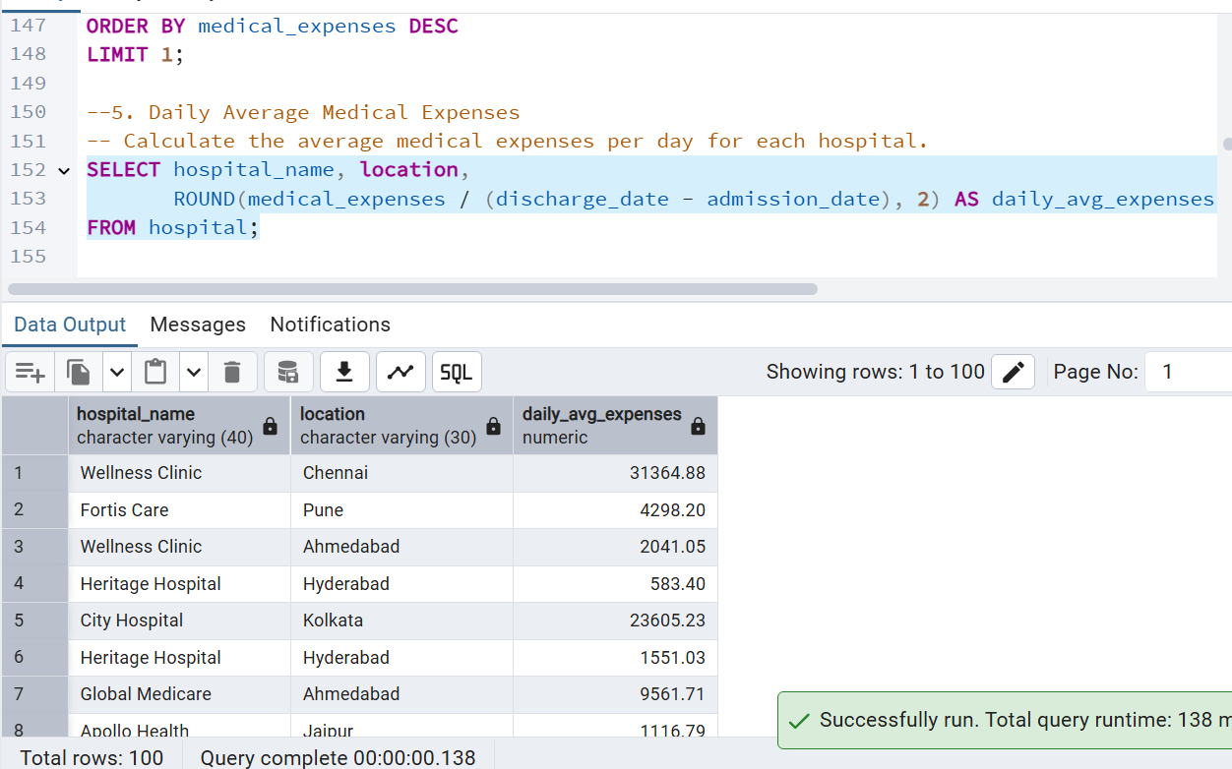
Sample SQL Queries
5. Daily Average Medical Expenses
Basic:
hospitals in Bangalore, <50 patients, admission after 2023-01-01, <10 doctors
SELECT hospital_name, location,
ROUND(medical_expenses / (discharge_date - admission_date), 2) AS daily_avg_expenses
FROM hospital;

Slide 17
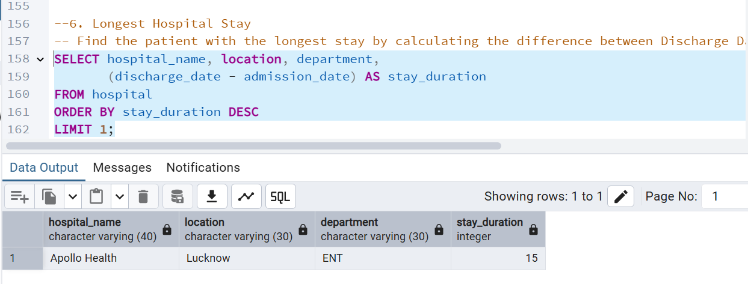
Sample SQL Queries
6. Longest Hospital Stay
Basic:
hospitals in Bangalore, <50 patients, admission after 2023-01-01, <10 doctors
SELECT hospital_name, location, department,
(discharge_date - admission_date) AS stay_duration
FROM hospital
ORDER BY stay_duration DESC
LIMIT 1;

Slide 18
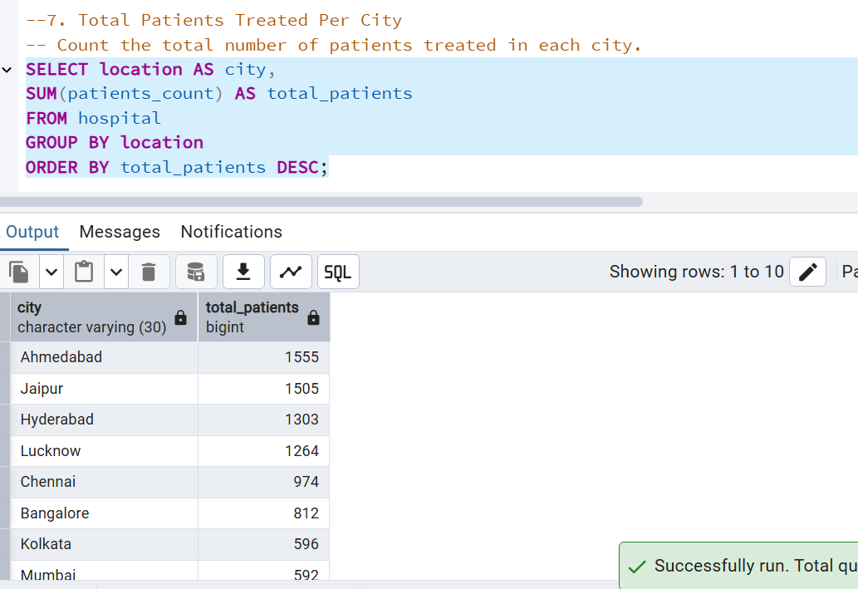
Sample SQL Queries
7. Total Patients Treated Per City
Basic:
hospitals in Bangalore, <50 patients, admission after 2023-01-01, <10 doctors
SELECT location AS city,
SUM(patients_count) AS total_patients
FROM hospital
GROUP BY location
ORDER BY total_patients DESC;

Slide 19
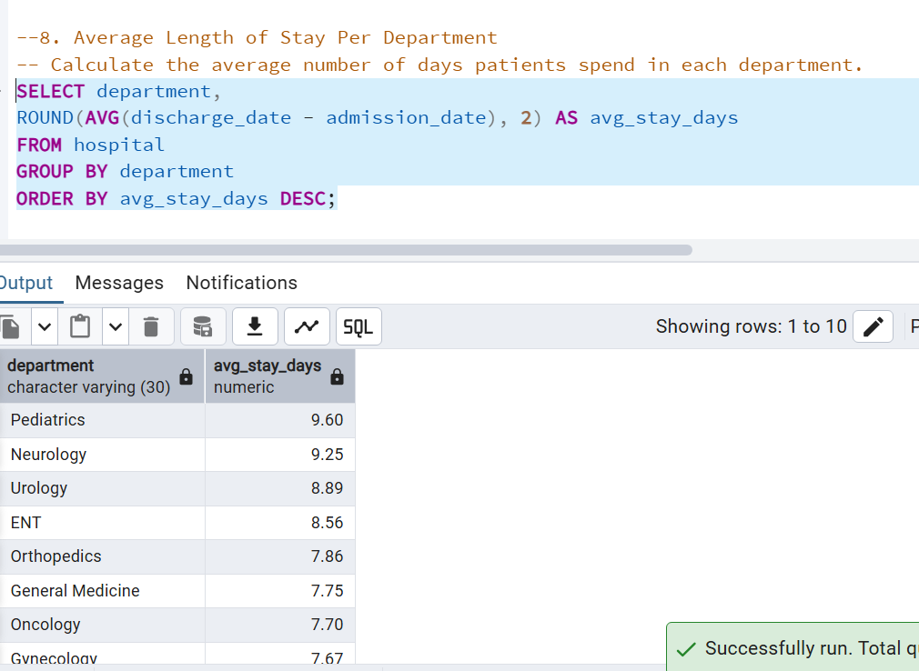
Sample SQL Queries
8. Average Length of Stay Per Department
Basic:
hospitals in Bangalore, <50 patients, admission after 2023-01-01, <10 doctors
SELECT department,
ROUND(AVG(discharge_date - admission_date), 2) AS avg_stay_days
FROM hospital
GROUP BY department
ORDER BY avg_stay_days DESC;

Slide 20
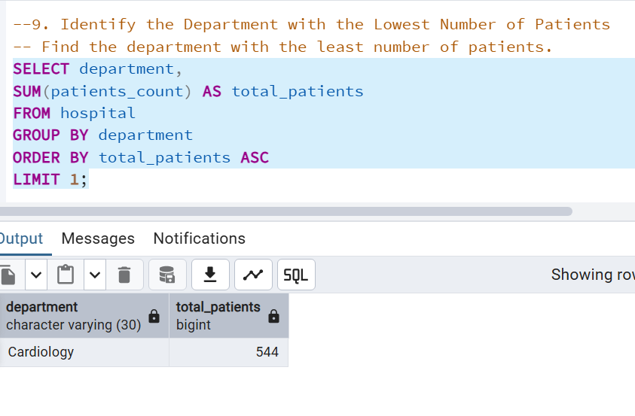
Sample SQL Queries
9. Identify the Department with the Lowest Number of Patients
Basic:
hospitals in Bangalore, <50 patients, admission after 2023-01-01, <10 doctors
SELECT department,
SUM(patients_count) AS total_patients
FROM hospital
GROUP BY department
ORDER BY total_patients ASC
LIMIT 1;

Slide 21
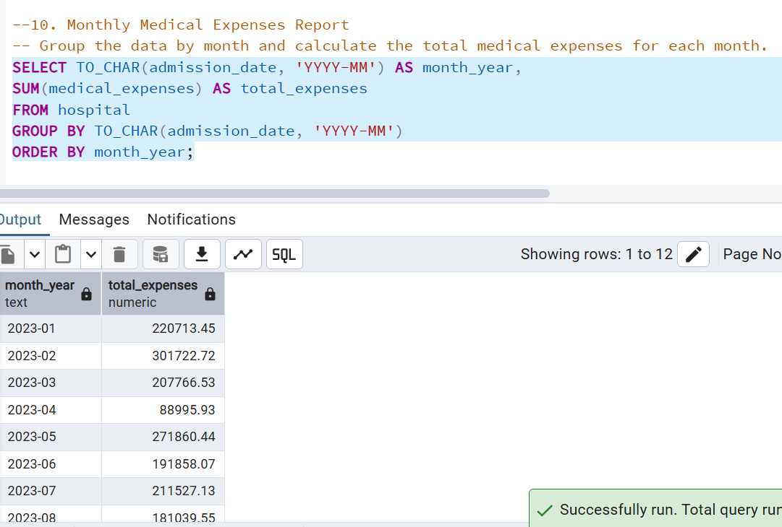
Sample SQL Queries
10. Monthly Medical Expenses Report
Basic:
hospitals in Bangalore, <50 patients, admission after 2023-01-01, <10 doctors
SELECT TO_CHAR(admission_date, 'YYYY-MM') AS month_year,
SUM(medical_expenses) AS total_expenses
FROM hospital
GROUP BY TO_CHAR(admission_date, 'YYYY-MM')
ORDER BY month_year;

Slide 22
Thank You!
Every great presentation is complete with a great audience
— and that’s you!

